Slide 1
UMET9U-30-1- Professional Skills for Banking and Finance Lecture 11
Presented by
Reinhold Heinlein
December 2025

Slide 2
Lecture content
Relationships between variables
Scatter graphs
Covariance and correlation coefficients

Slide 3
Correlation analysis
Data of paired observations can be used to study relationships between the variables.
Up to here, we studied variables on their own, now we have paired observations, and are interested in relationships.
Relationships can be studied by using graphical analysis or by computing correlation coefficients.

Slide 4
Correlation analysis
Paired observations can be cross-sectional or time series data.
Example for cross-sectional data: Revenues of 20 different companies in the year 2025. And, number of employees of the same companies in the same year. Positive correlation of the two variables is expected. A company with more employees might have higher revenues.
Example for time series data: Annual inflation rates of two countries for the time period 2000 to 2025. Most likely inflation will be high at similar points in time. Hence, positive correlation is expected.

Slide 5
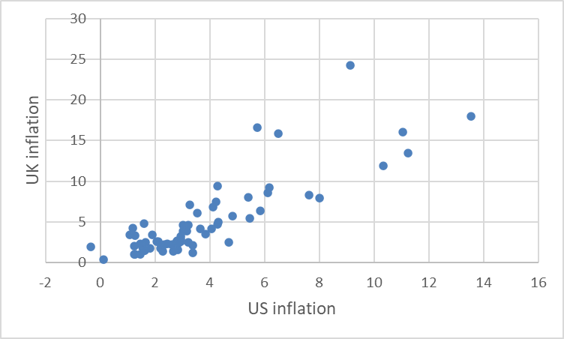
Graphical analysis - Example
Figure: Inflation, consumer prices for the US and the UK, annual, 1960-2024.

Slide 6
Graphical correlation analysis
Positive correlation: When x-values are high, y-values tend to be high. The data cloud is an elliptic upward sloping shape.
Negative correlation: When x-values are high, y-values tend to be low. The data cloud is an elliptic downward sloping shape.
No correlation: When x-values and y-values seem not to be connected. The data cloud looks like a random circle of dots.

Slide 7
The covariance
The covariance between two variables X and Y measures the extent to which a variation in one is positively or negatively associated with a variation in the other. That is, when one goes up, does the other tend to go up or down?
E.g. Price and quantity demanded, income and consumption, money supply and inflation.
Like the variance, the co-variance is calculated using the differences of each observation from the mean.

Slide 8
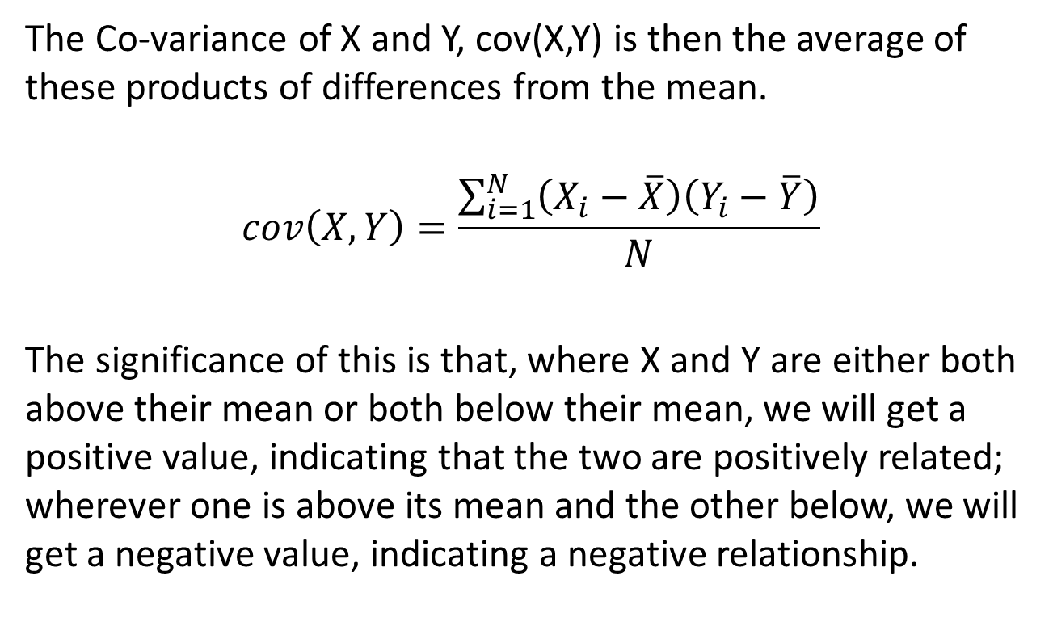
The covariance
The Co-variance of X and Y, cov(X,Y) is then the average of these products of differences from the mean.
$$cov\left(X,Y\right)=\frac{\sum_{i=1}^{N}{\left(X_{i}−\overline{X}\right)\left(Y_{i}−\overline{Y}\right)}}{N}$$
The significance of this is that, where X and Y are either both above their mean or both below their mean, we will get a positive value, indicating that the two are positively related; wherever one is above its mean and the other below, we will get a negative value, indicating a negative relationship.

Slide 9
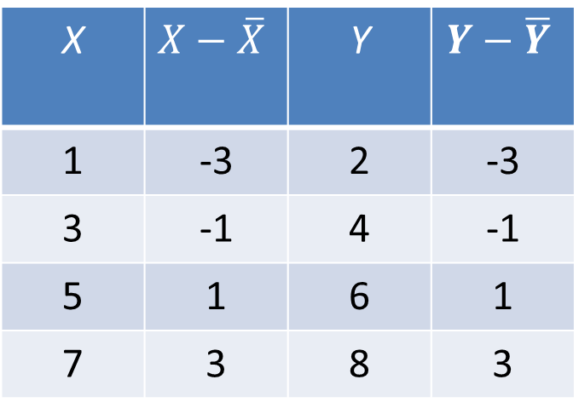

Covariance example 1
$$cov\left(X,Y\right)=\frac{\sum_{i=1}^{N}{\left(X_{i}−\overline{X}\right)\left(Y_{i}−\overline{Y}\right)}}{N}$$
$\overline{X}=4$
$\overline{Y}=5$
$$cov\left(X,Y\right)=\frac{9+1+1+9}{4}=5$$
X | $$X−\overline{X}$$ | Y | $$Y−\overline{Y}$$
1 | -3 | 2 | -3
3 | -1 | 4 | -1
5 | 1 | 6 | 1
7 | 3 | 8 | 3

Slide 10
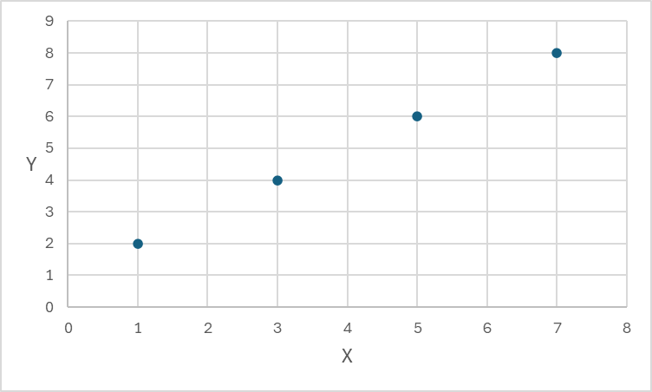

Covariance example 1
X | 1 | 3 | 5 | 7
Y | 2 | 4 | 6 | 8
$cov\left(X,Y\right)=5$

Slide 11
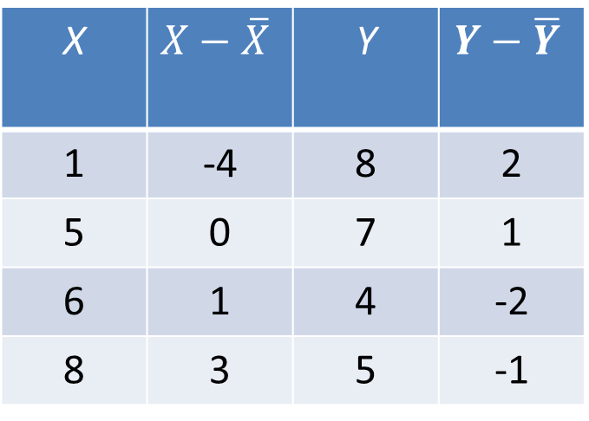

Covariance example 2
$$cov\left(X,Y\right)=\frac{\sum_{i=1}^{N}{\left(X_{i}−\overline{X}\right)\left(Y_{i}−\overline{Y}\right)}}{N}$$
$\overline{X}=5$
$\overline{Y}=6$
$$cov\left(X,Y\right)=\frac{−8+0−2−3}{4}=\frac{−13}{4}=−3.25$$
X | $$X−\overline{X}$$ | Y | $$Y−\overline{Y}$$
1 | -4 | 8 | 2
5 | 0 | 7 | 1
6 | 1 | 4 | -2
8 | 3 | 5 | -1

Slide 12
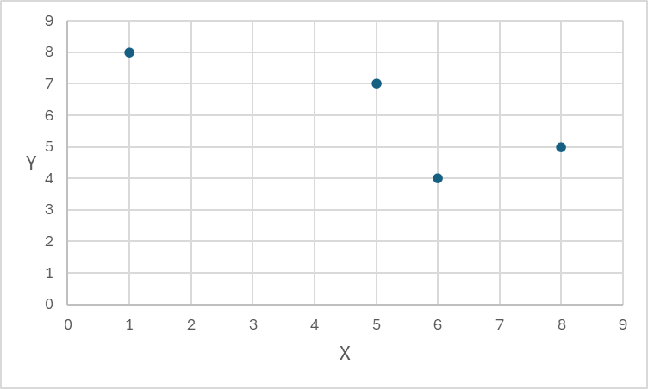

Covariance example 2
X | 1 | 5 | 6 | 8
Y | 8 | 7 | 4 | 5
$cov\left(X,Y\right)=$
$−3.25$

Slide 13
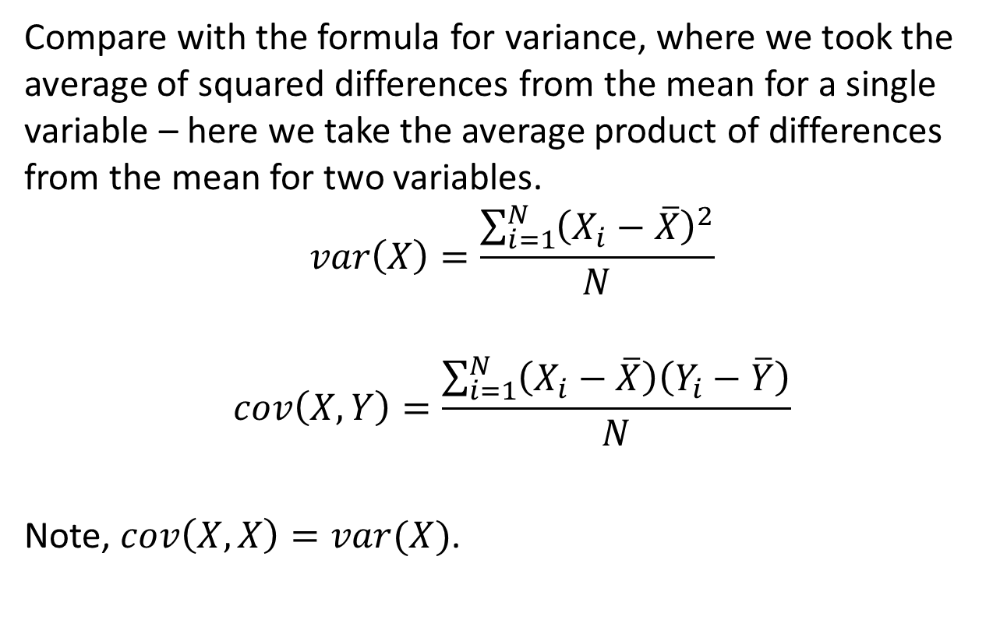
The covariance
Compare with the formula for variance, where we took the average of squared differences from the mean for a single variable – here we take the average product of differences from the mean for two variables.
$$var\left(X\right)=\frac{\sum_{i=1}^{N}{{\left(X_{i}−\overline{X}\right)}^{2}}}{N}$$
$$cov\left(X,Y\right)=\frac{\sum_{i=1}^{N}{\left(X_{i}−\overline{X}\right)\left(Y_{i}−\overline{Y}\right)}}{N}$$
Note, $cov\left(X,X\right)=var(X)$.

Slide 14
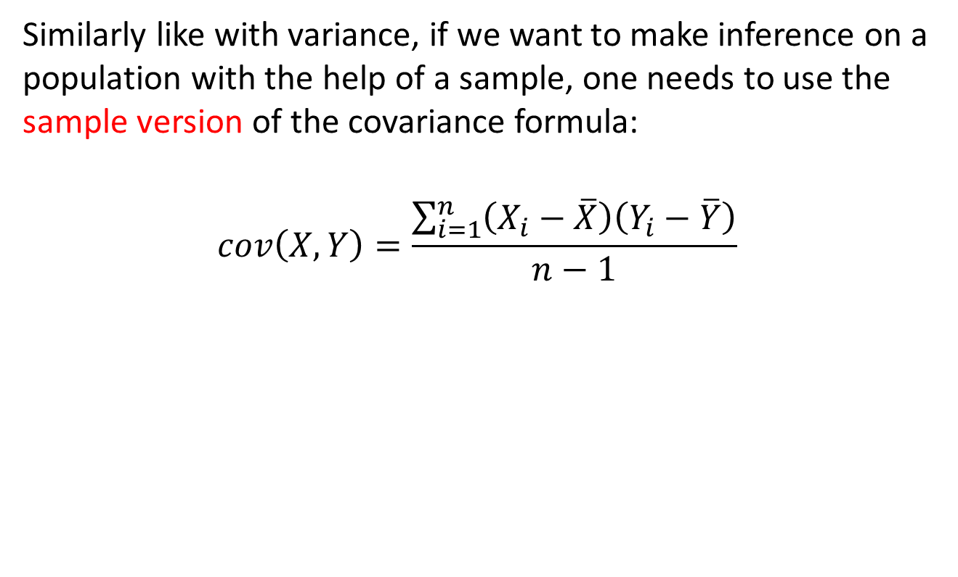
The covariance
Similarly like with variance, if we want to make inference on a population with the help of a sample, one needs to use the sample version of the covariance formula:
$$cov\left(X,Y\right)=\frac{\sum_{i=1}^{n}{\left(X_{i}−\overline{X}\right)\left(Y_{i}−\overline{Y}\right)}}{n−1}$$

Slide 15
The correlation coefficient
The co-variance is of some use, but the problem is that its size depends on the size of the numbers we’re dealing with for each variable – so if you measured the variables in different units, you’d get a different answer.
To obtain a measure of the relationship between the variables that does not depend on the absolute size of the numbers, and which we can therefore compare across datasets, we scale the co-variance according to the standard deviation of each variable.
This gives the Correlation Coefficient (precisely, the Pearson Product Moment Correlation Coefficient), R.

Slide 16
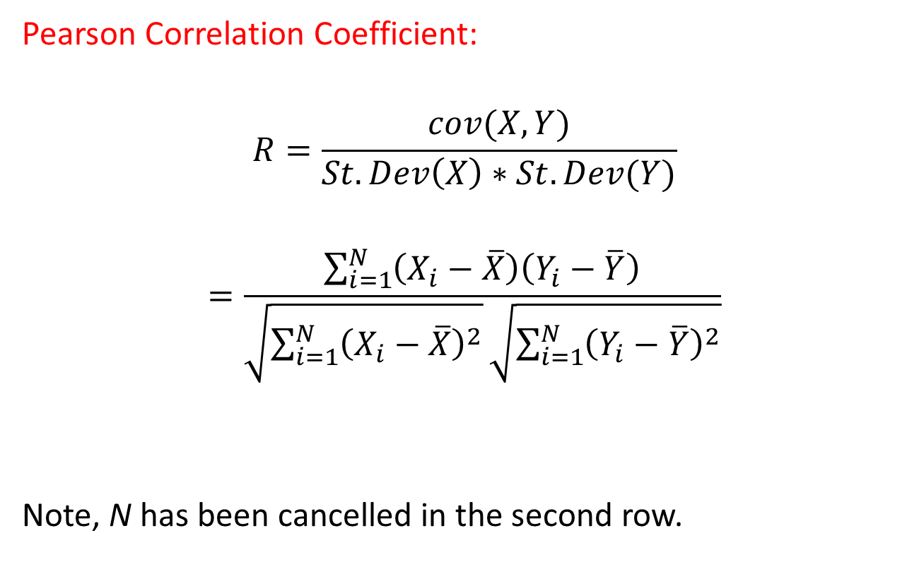
The correlation coefficient
Pearson Correlation Coefficient:
$$R=\frac{cov(X,Y)}{St.Dev\left(X\right)∗St.Dev(Y)}$$
$$=\frac{\sum_{i=1}^{N}{\left(X_{i}−\overline{X}\right)\left(Y_{i}−\overline{Y}\right)}}{\sqrt{\sum_{i=1}^{N}{{\left(X_{i}−\overline{X}\right)}^{2}}}\sqrt{\sum_{i=1}^{N}{{\left(Y_{i}−\overline{Y}\right)}^{2}}}}$$
Note, N has been cancelled in the second row.

Slide 17
Properties of the correlation coefficient
The correlation coefficient always lies between -1 and +1.
A positive value of R indicates that the variables tend to move together; a negative value, that they tend to move in opposite directions.
The higher the absolute value of R, the closer the relationship.
If R=0, it means there is no (linear) relationship between the variables

Slide 18
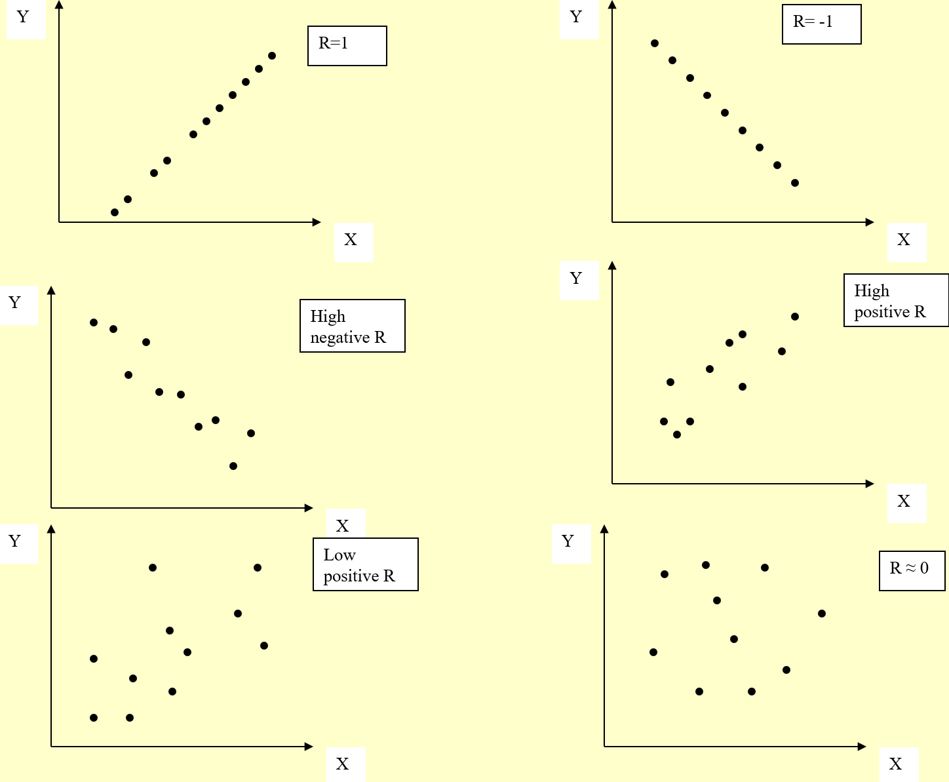

Slide 19

Correlation example 1
X | 1 | 3 | 5 | 7
Y | 2 | 4 | 6 | 8
$cov\left(X,Y\right)=5$
$St.Dev\left(X\right)=2.236$
$St.Dev\left(Y\right)=2.236$
$cor(X,Y)=1$

Slide 20

Covariance example 2
X | 1 | 5 | 6 | 8
Y | 8 | 7 | 4 | 5
$cov\left(X,Y\right)=−3.25$
$St.Dev\left(X\right)=2.55$
$St.Dev\left(Y\right)=1.58$
$cor\left(X,Y\right)=−0.806$

Slide 21
Limitations of correlation analysis
CORRELATION DOES NOT IMPLY CAUSATION!
There can be many reasons why two variables A and B are statistically correlated:
A causes B
B causes A
Something else, C say, causes both A and B
Co-incidence
Problems with the data
For example, a common occurrence in case 3 is where the variable C is time – that is, if both variables tend to increase or decrease over time, quite independently of each other.

Slide 22
Next Lecture
Probability distributions
Binomial distribution
Normal distribution
Z table

